Slide 1
Engaging Your Students
How do YOU engage your students?
TEXT 737610 and your response to 37607

Slide 2
Infusing Technology
Increasing Engagement
Maggie Phillips
Kenya Ransey

Slide 3
Student Engagement
Engaged students make a psychological investment in learning and take pride in their effort. Because their work has clear meaning to their lives, they remain actively involved in understanding and internalizing content instead of simply earning grades.

Slide 4
Session Objective
Share a variety of digital tools and resources that can be used by third grade teachers to increase instructional effectiveness and increase student engagement.

Slide 5
ENGAGEMENT STRATEGIES

Slide 6
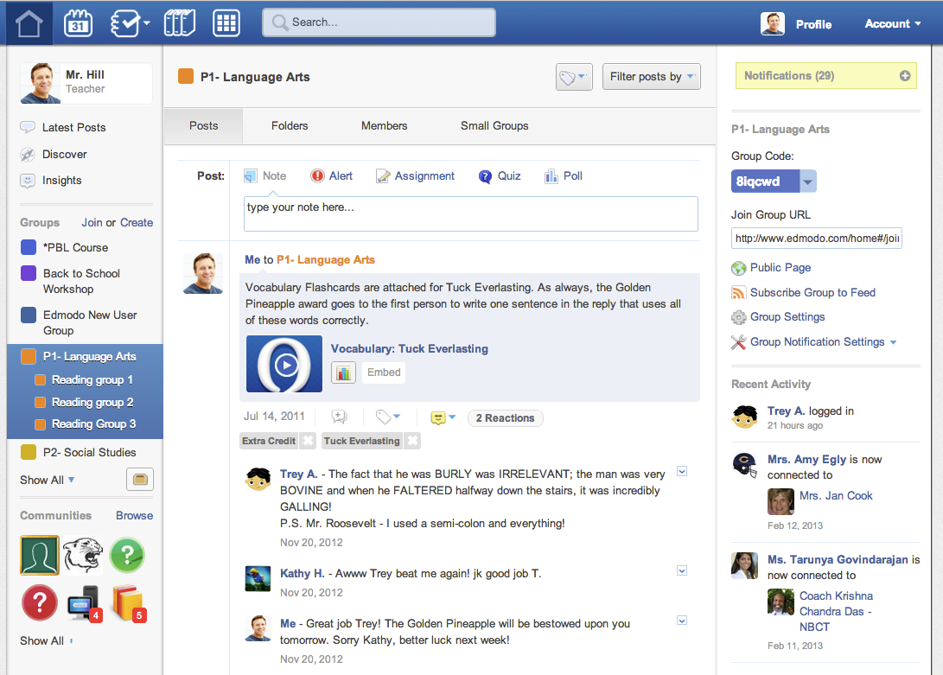
Social Learning Platform for teachers, students, and parents
Post information for students to access online
Create polls and gather data
Create collaborative learning groups
Share digital resources

Slide 7
TedED: Lessons Worth Sharing
Video Clips and Lesson Resources related to all content areas
Teacher created with visuals and diverse animations
Lesson and video creation tools

Slide 8
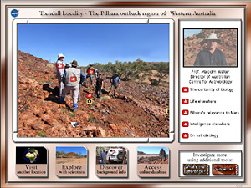
Virtual Field Trips
Use Virtual Field Trips to build background knowledge and ignite student interest
Ellis Island Virtual Field Trip (integrates content, reading of extended texts, and ELA standards
Notes:
Clicking on “Virtual Field Trips” will bring you to the website you sent: http://askatechteacher.wordpress.com/2009/10/27/10-great-virtual-field-trips/
Might want to mention that virtual field trips can be used across the content area… to inspire ideas for writing, to build background knowledge for literacy, etc.

Slide 9
Turn and Talk
Talk with the people around you about how you might use these tools and resources to support student engagement and enhance instruction!

Slide 10
Book Trailers
Get kids excited about upcoming extended texts!
Hook your guided reading group on their next book.

Slide 11
Lesson Movie Trailers

Slide 12
Lesson Movie Trailers
Movies coming soon to theaters or recently released

Slide 13
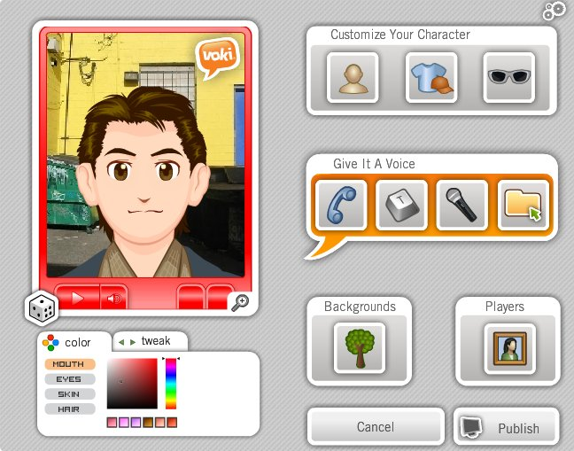
Voki
Free, web tool that allows you to create customized speaking characters
Teachers use to increase engagement
Students use to share their knowledge and learning.
Notes:
Click on the picture for an example third grade VOKI.

Slide 14
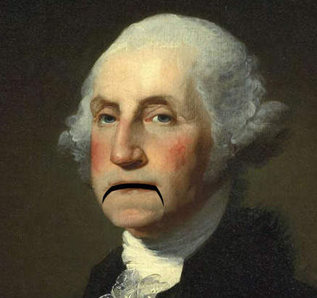
Blabberize
Turn pictures into talking animations
Introduce topics (overview)
Present historical figures in Social Studies with their pictures
Use pop-culture people in pictures to present problems or content.
Students create to share knowledge (animal adaptations)

Slide 15
Turn and Talk
Talk with the people around you about how you might use these tools and resources to support student engagement and enhance instruction!

Slide 16
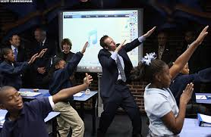
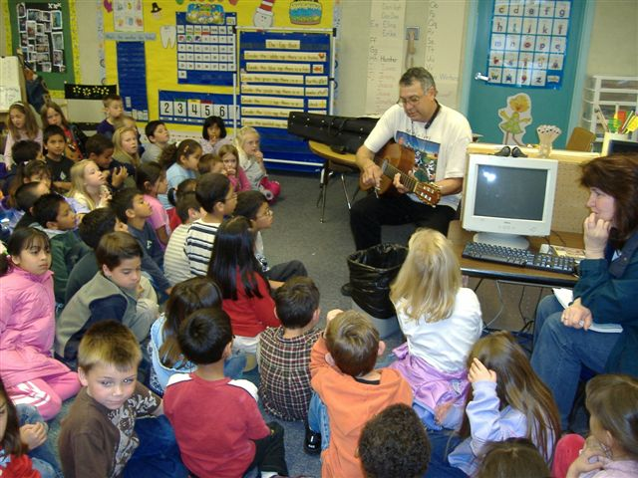
Use MUSIC
Katy Perry parody for conjunctions
Justin Bieber’s “Baby”
Beatles “Yellow Submarine”

Slide 17
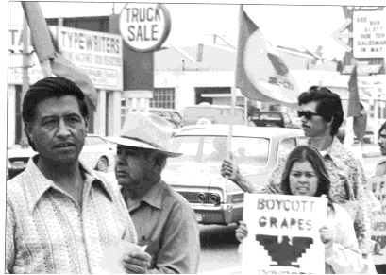
Virtual Simulations
BBC Science Simulations
PhET Interactive Simulations (Science and Math Resources)
Virtual Science
Teaching American History Simulations (Key historical events in interactive formats)

Slide 18
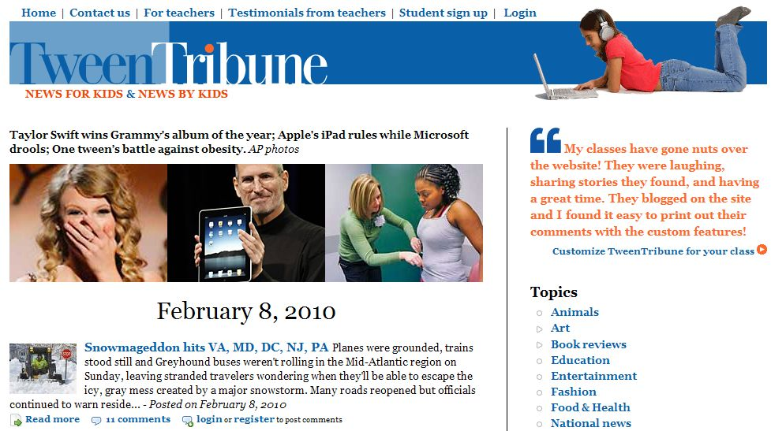
Tween Tribune
Literacy resources related to kid-friendly news
Leveled articles related to diverse topics
Embedded questions and discussion points (can be answered online or on paper)

Slide 19
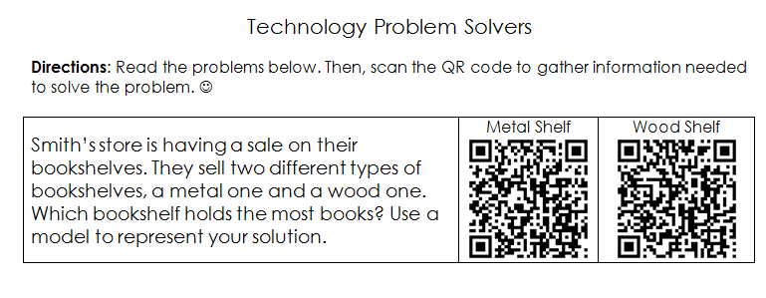
QR Codes
A black and white image used to share information
Word Problems
Links to additional resources
Extension tasks
Self-Checking codes
Clues to scavenger hunt

Slide 20
Turn and Talk
Talk with the people around you about how you might use these tools and resources to support student engagement and enhance instruction!

